Slide 1

TEAM
CREST
PRESENTS
ELECTION
MANAGEMENT
SYSTEM

Slide 2


MADE UNDER THE GUIDANCE OF
TEAM MEMBERS
Apurv kumar (2020B0313001),
Vasu Singhal (2020B0313002),
Mohd Anas (2020B0313003),
Sagar Sharma (2020B0313004)
Our mentor Dr. B P Sharma (sir)

Slide 3
Domain
Election Management System creates and handles details regarding polling and election which will enable all citizens (voters) to cast their vote via this system. Database consisting of records and details of the citizens (voters) and candidates who are eligible to vote are maintained by the system.

Slide 4
Project Description
This Election Management System will help you manage your elections easily and securely. This system sack of high performance, high security and to reduces the fake votes to the Election system.
This voting system can be used for casting votes during the elections held in colleges, etc. In this system the voters do not have to go to the polling booth to cast their vote. They can use their personal computer to cast their votes.
There is a database which is maintained in which all the name of the voters with their complete information is stored. The System Administrator registers the voters by simply filling a registration form to register the voters.

Slide 5
After registration, the voter is assigned a unique voter ID with password which he/she can use to login to the system and can select his/her favorite candidates to cast the vote. If invalid/wrong details are submitted, then the person is not registered to vote. Users can enter choice as per performance and can see total votes and leading candidate.
It saves time and avoids errors such as invalid votes and miscalculation of votes. The election process is easy, and this system proves to be much economical, compared to the manual system.

Slide 6
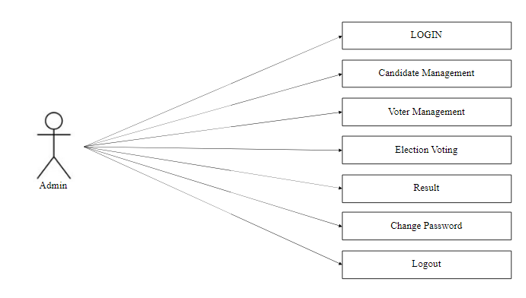
Use Case Diagram

Slide 7
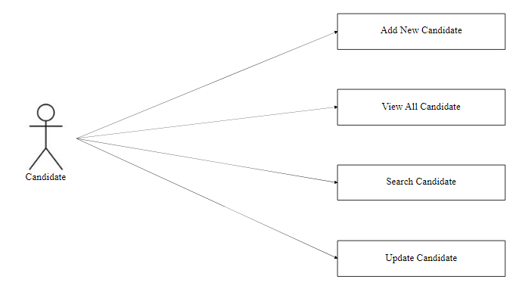

Slide 8
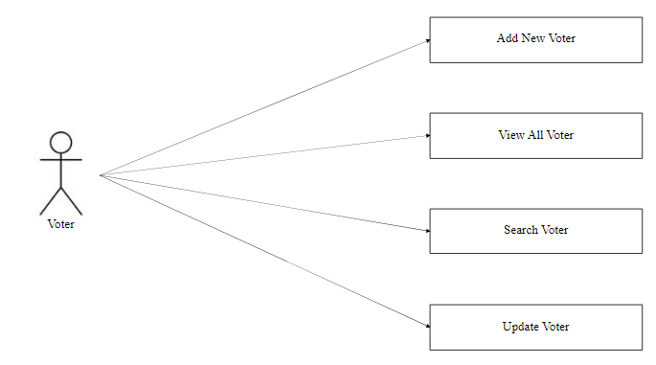

Slide 9
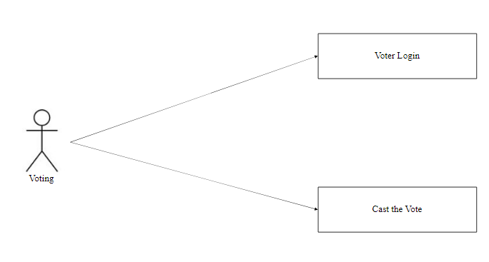

Slide 10
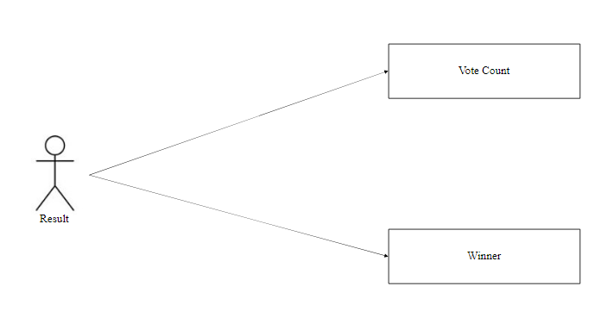

Slide 11

Project Screens

Slide 12
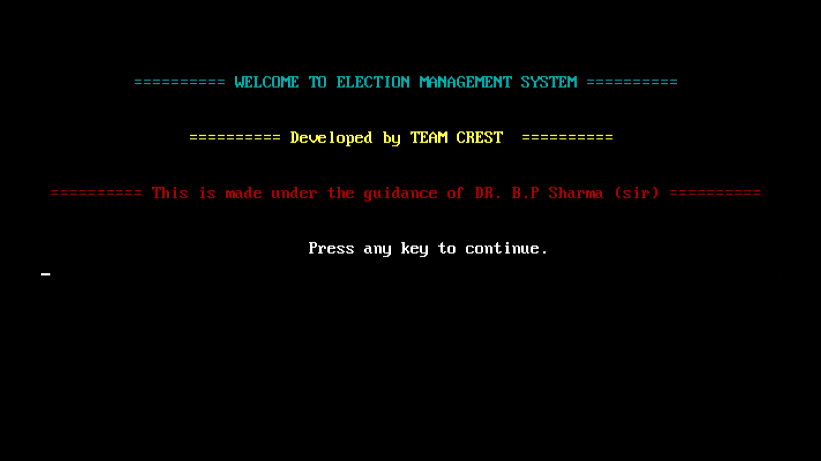

Slide 13
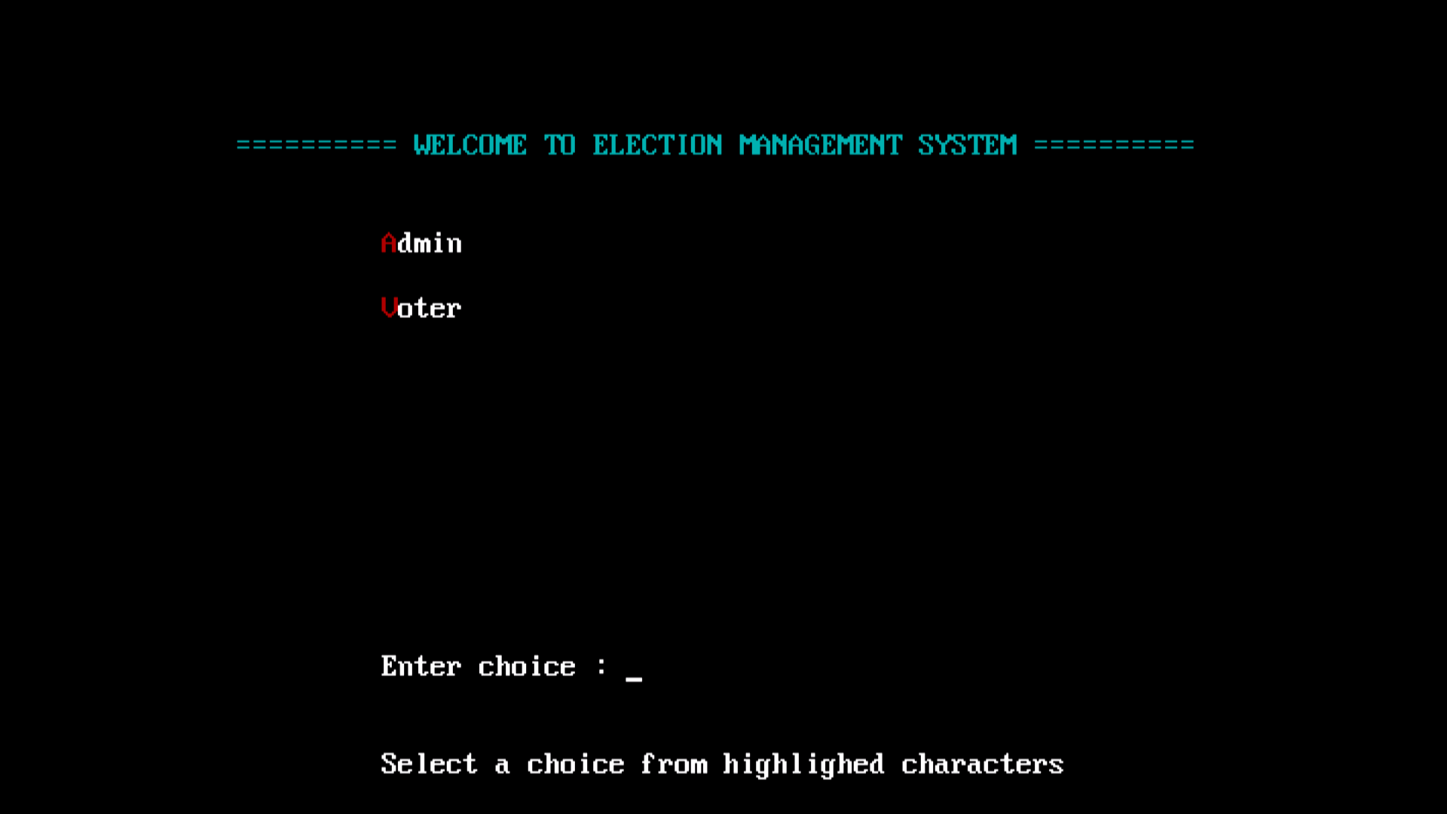

Slide 14
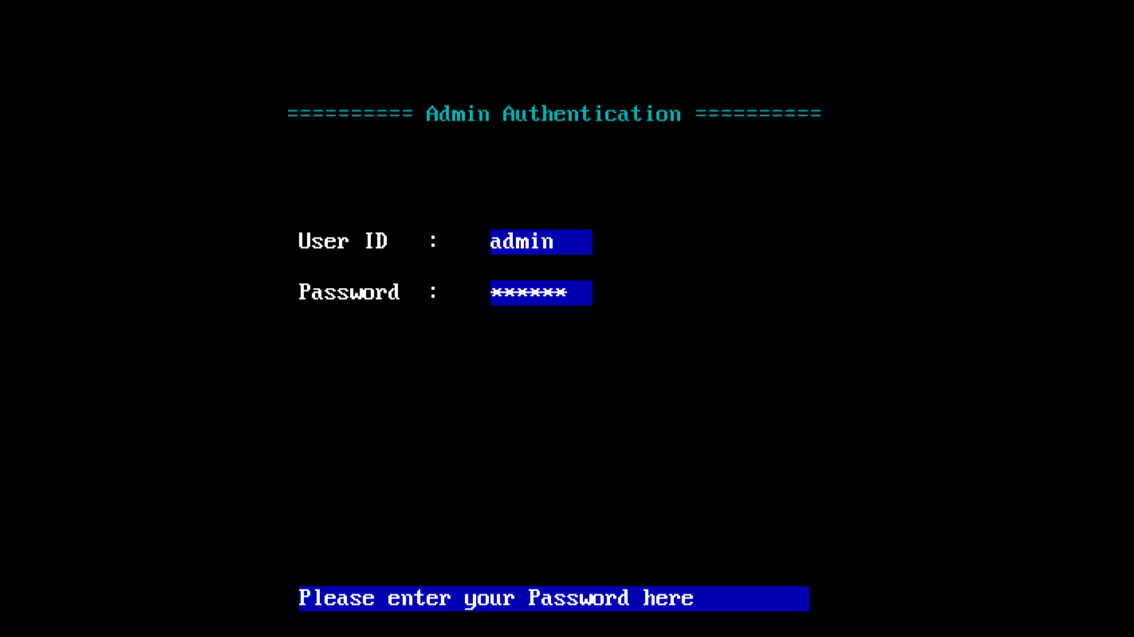

Slide 15
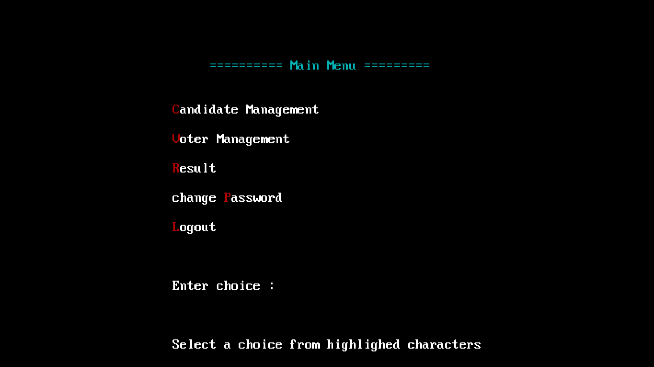

Slide 16
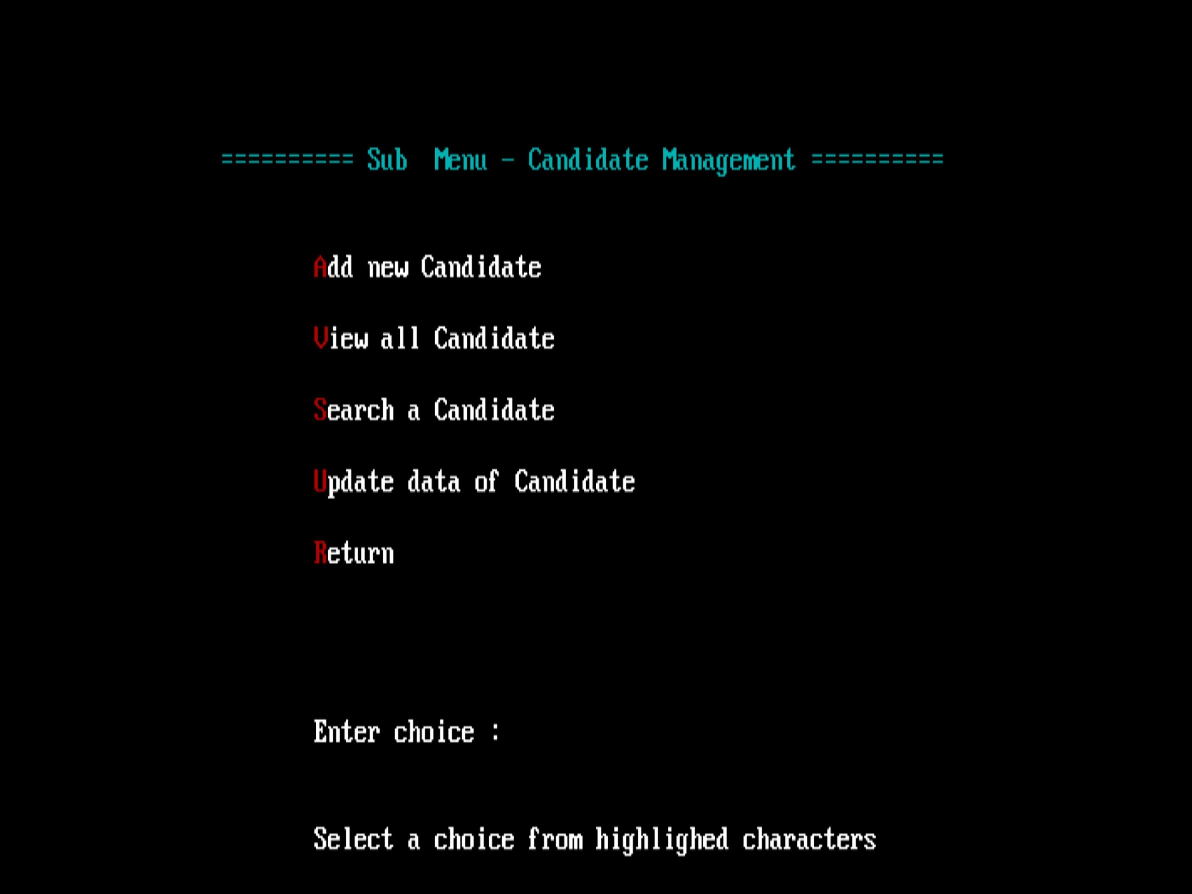

Slide 17
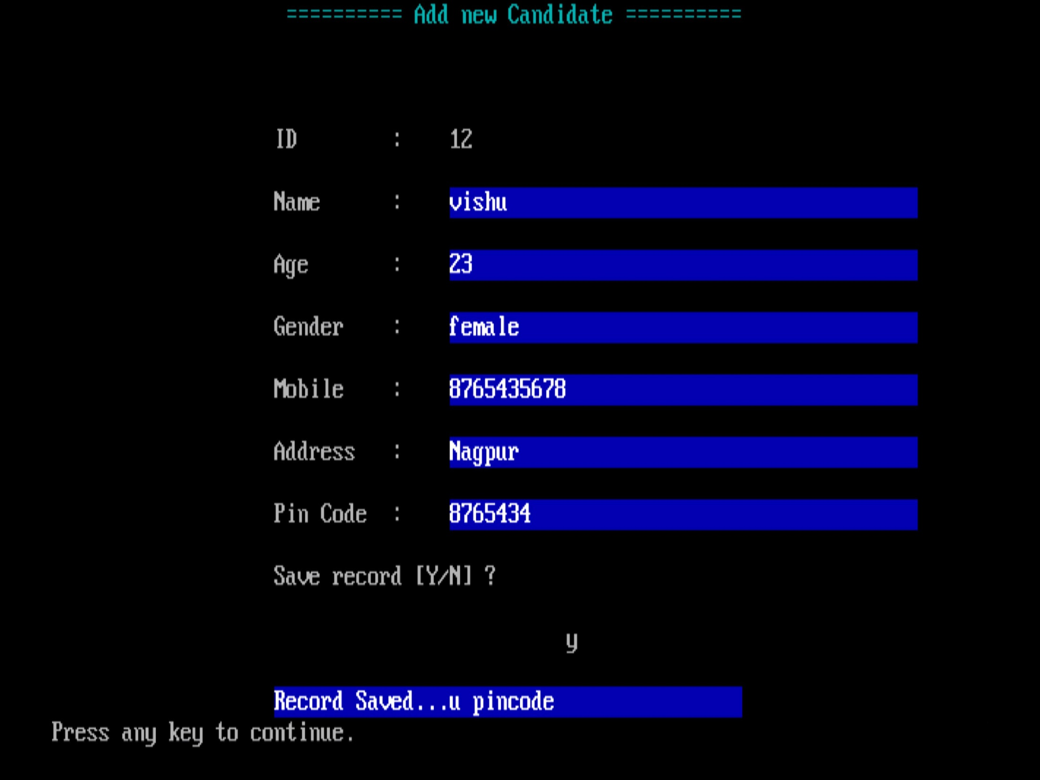

Slide 18
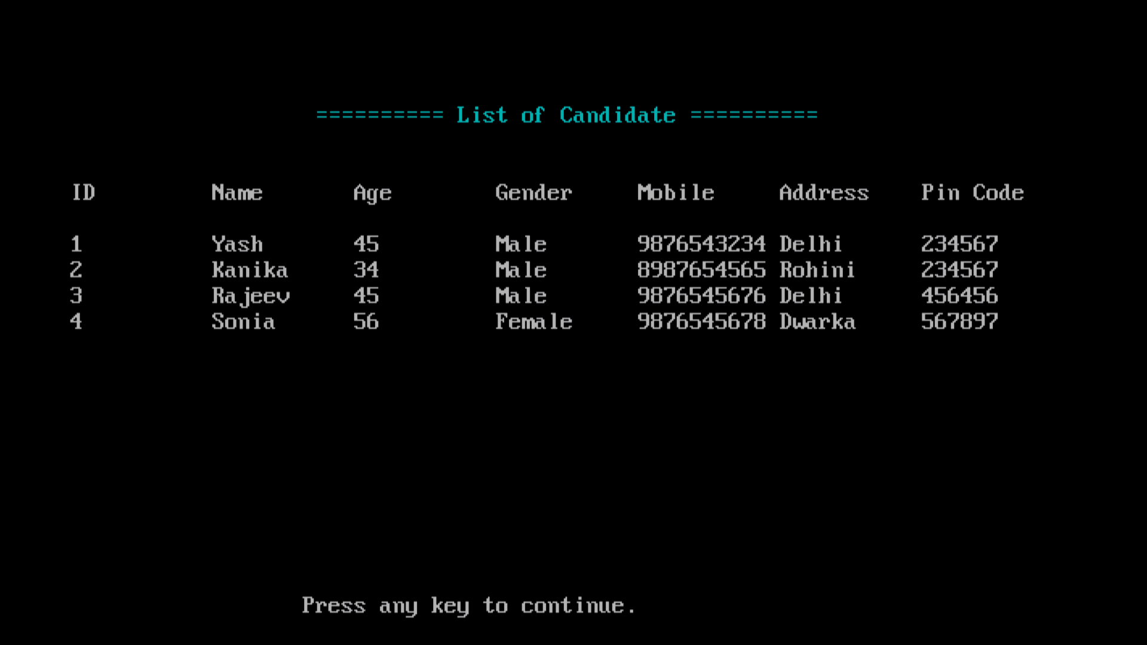

Slide 19
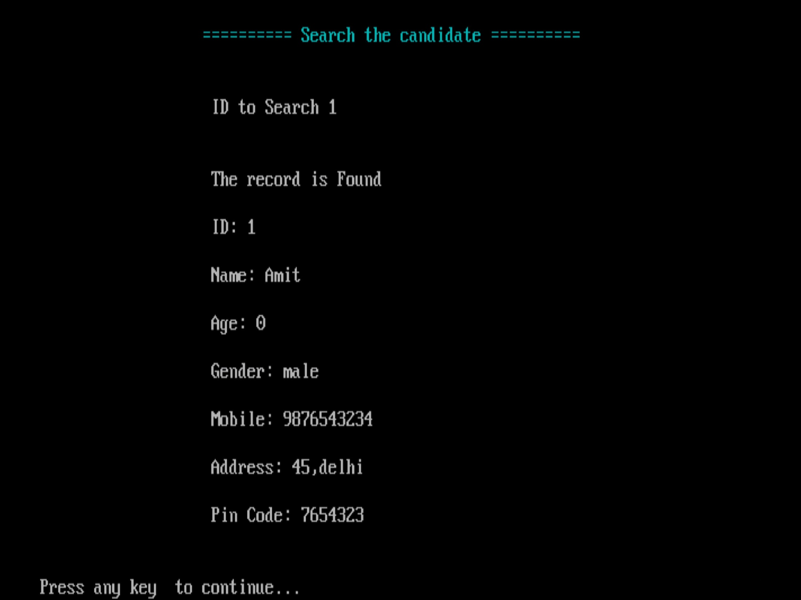

Slide 20
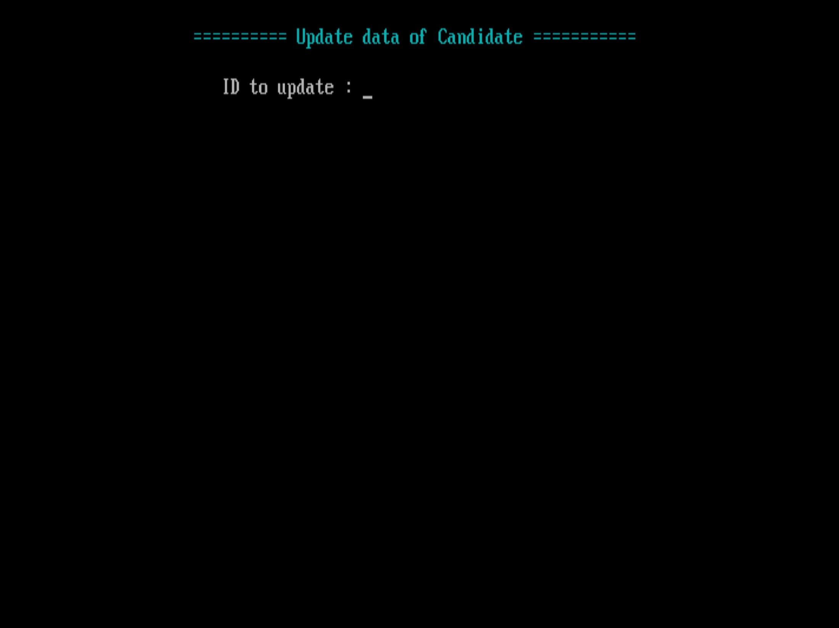

Slide 21
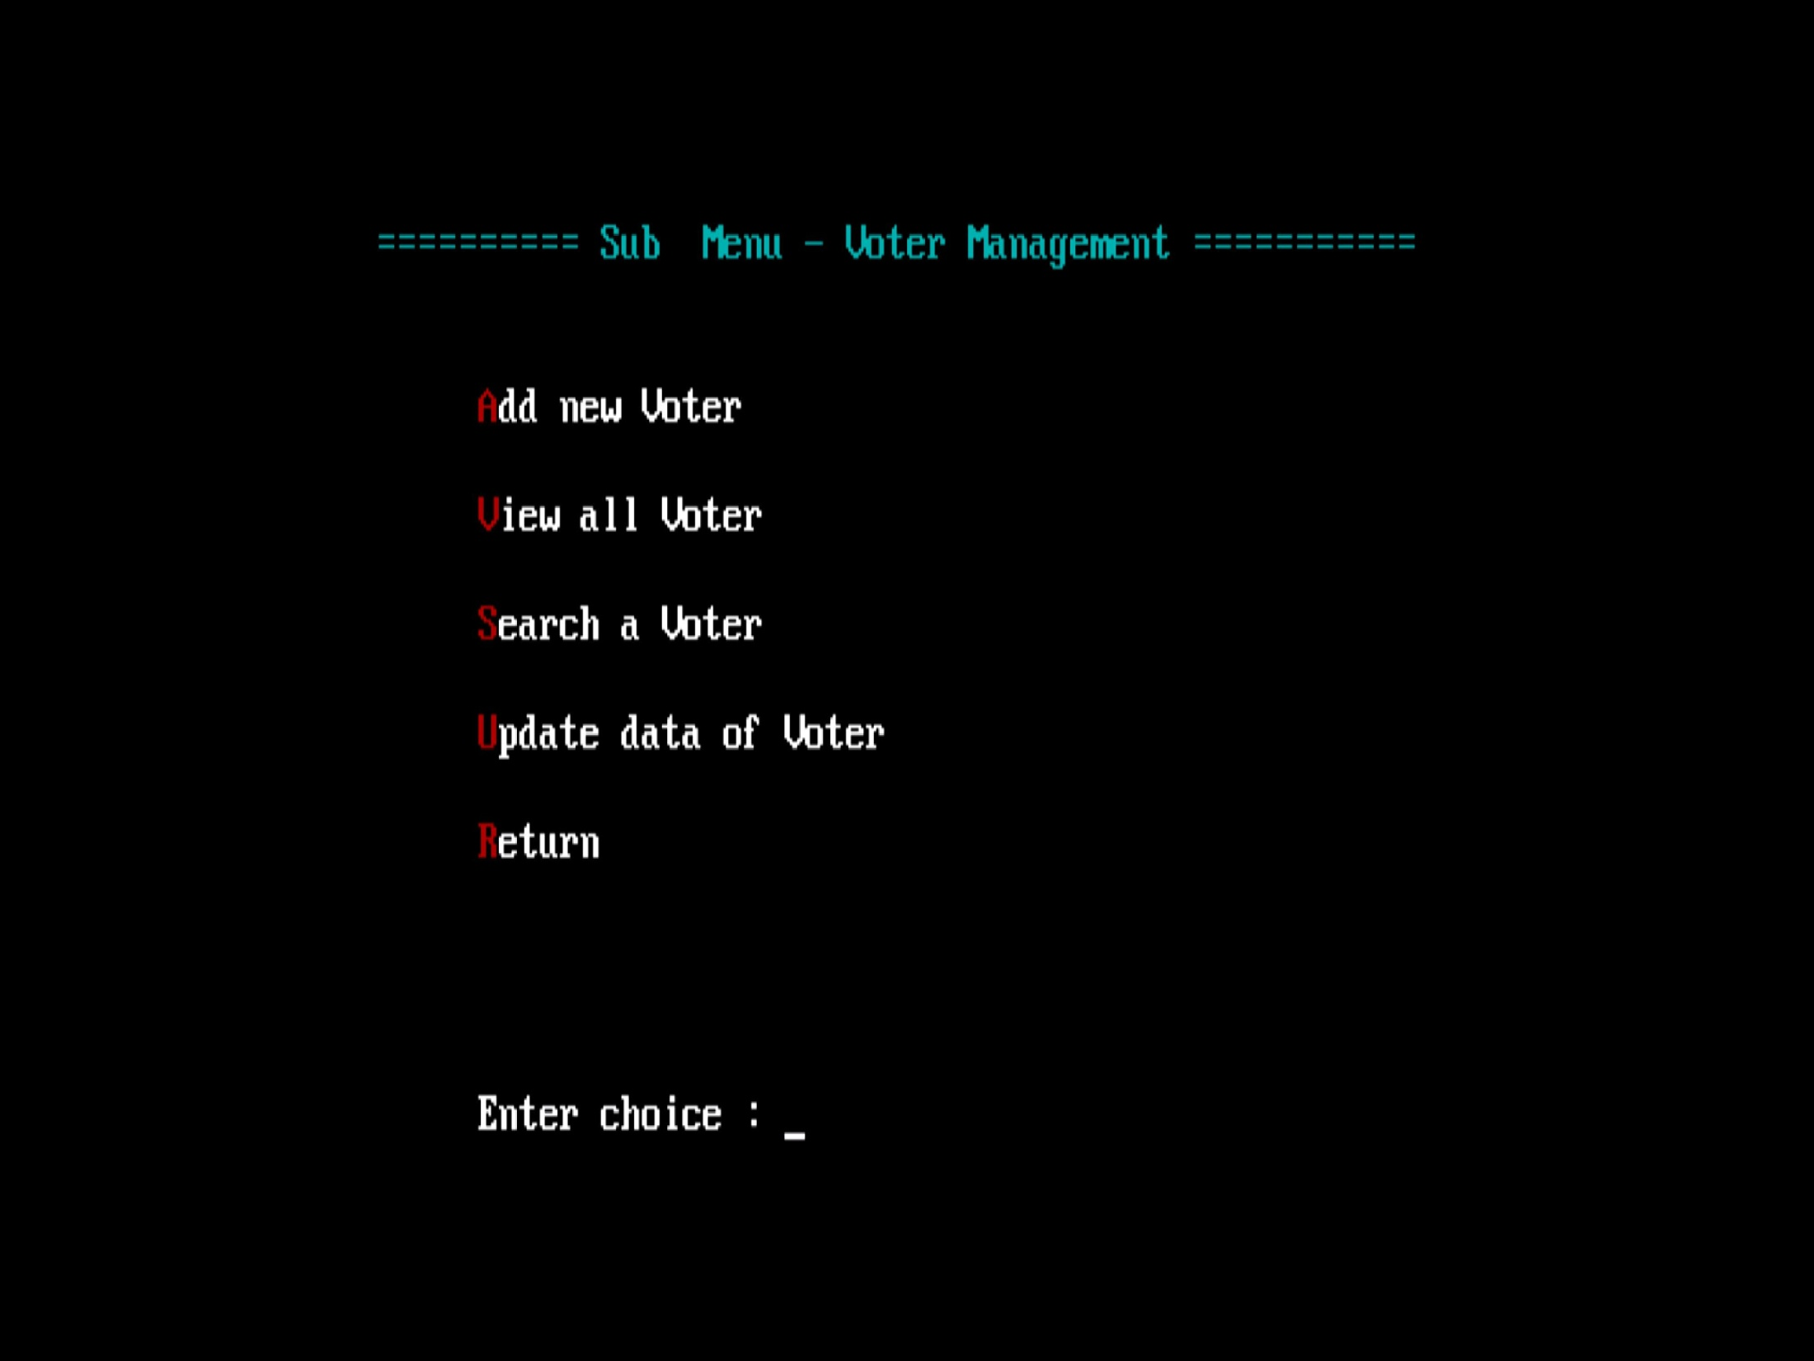

Slide 22
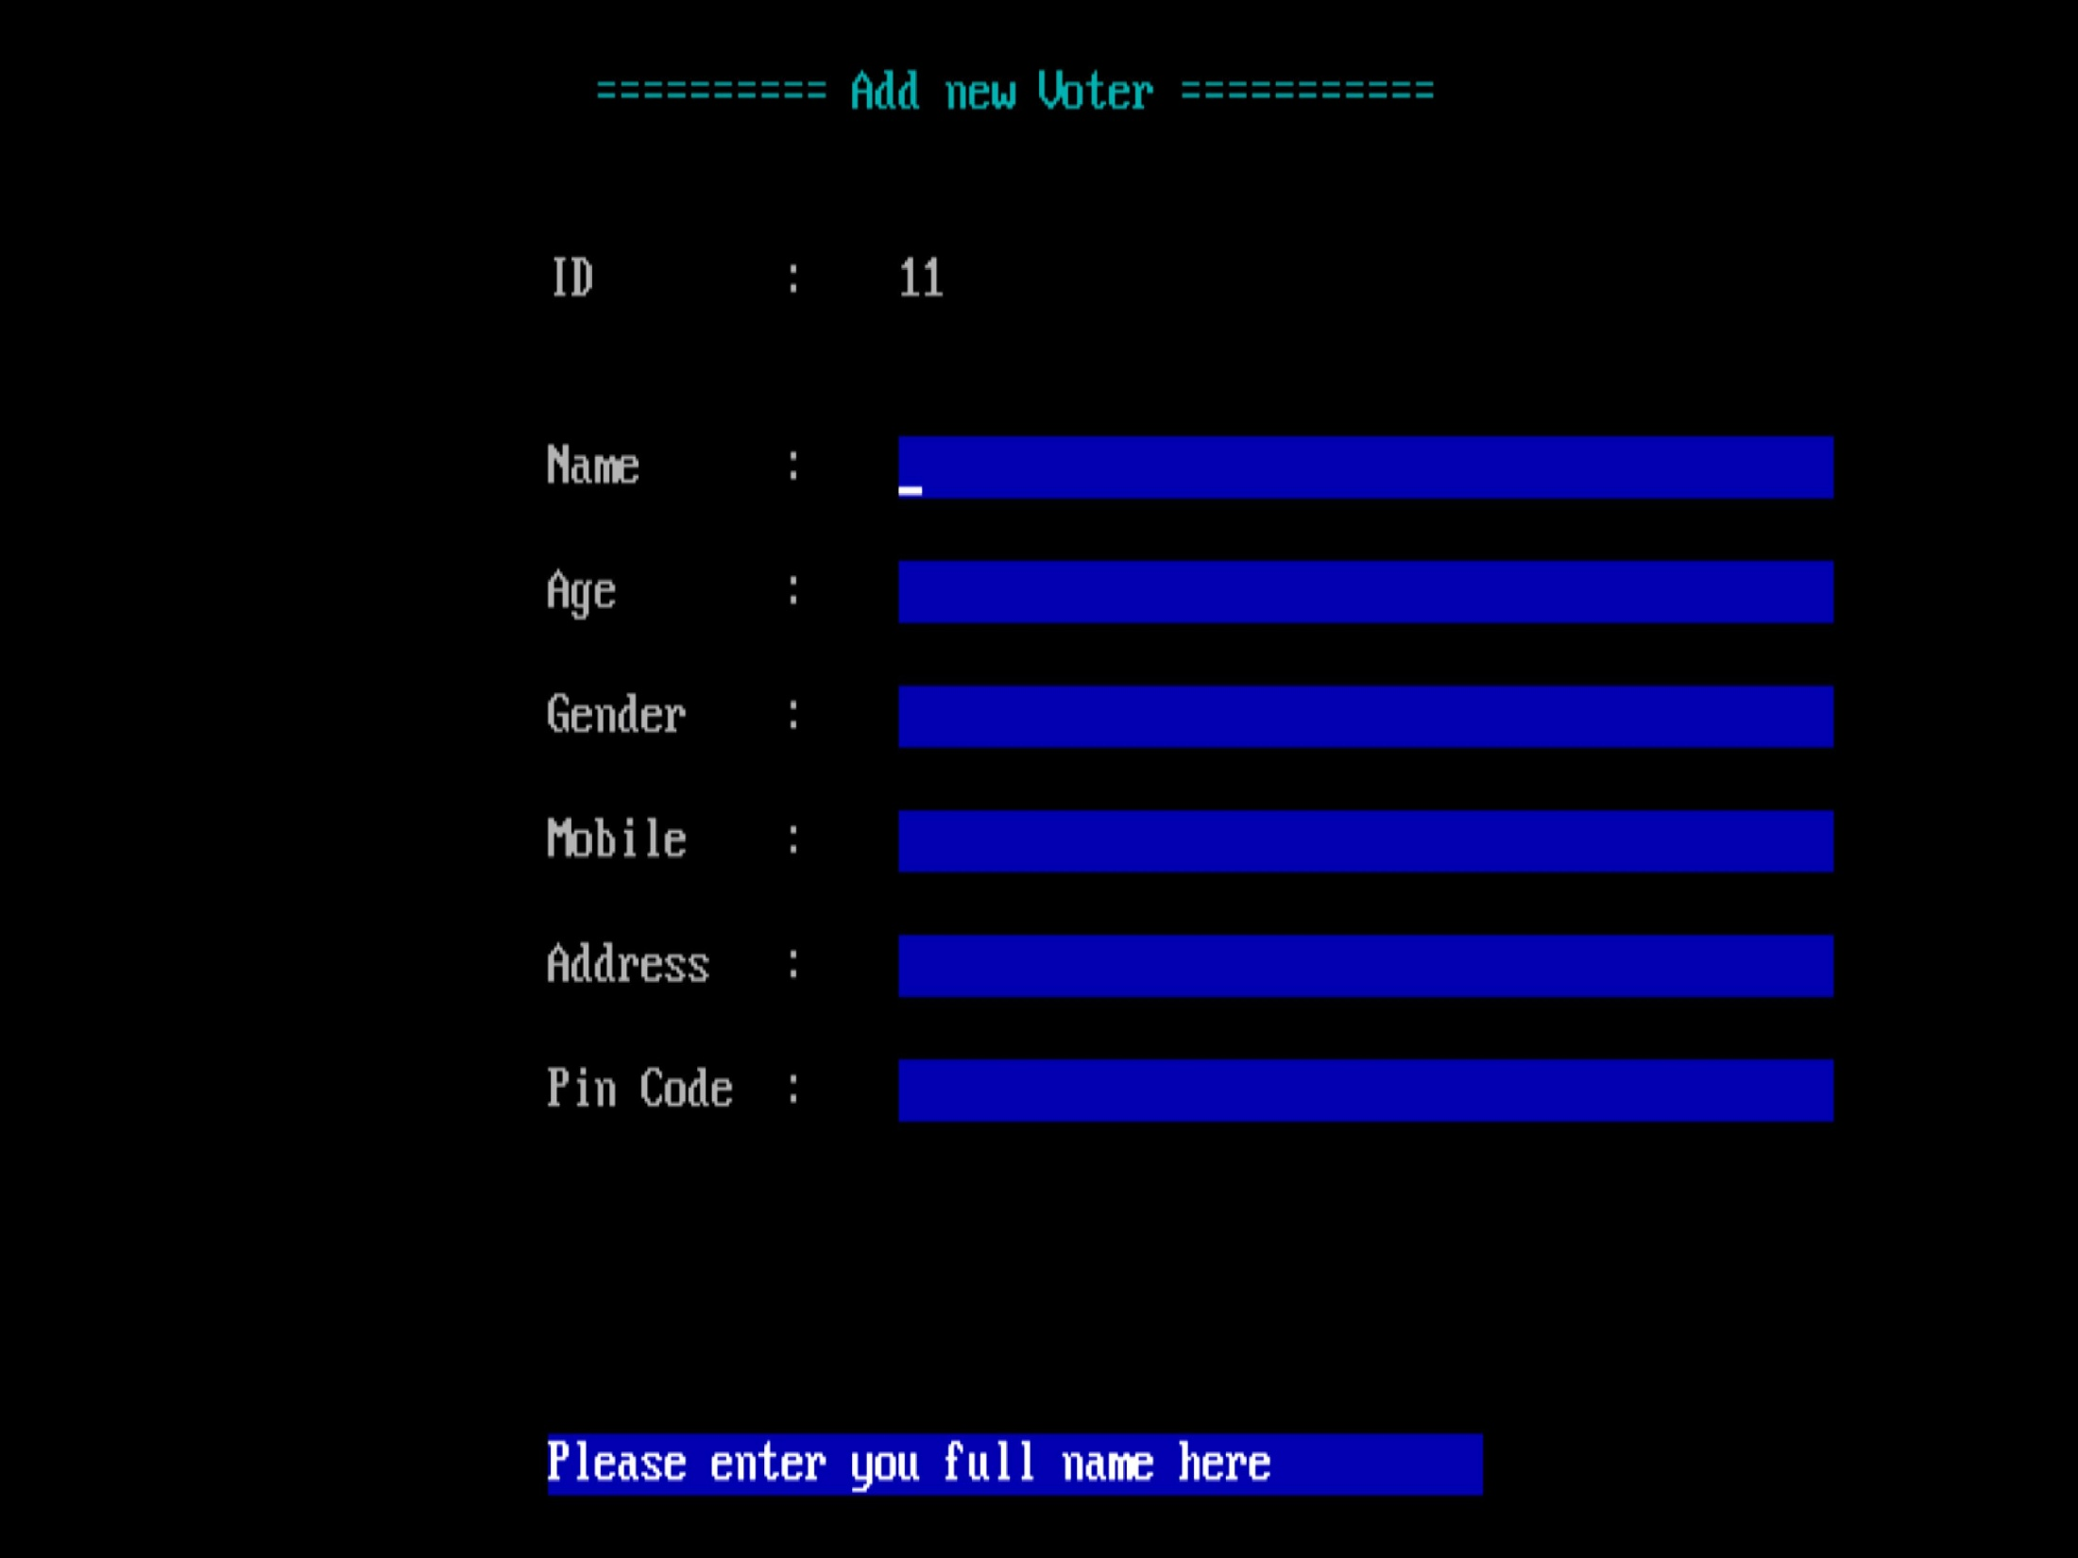

Slide 23
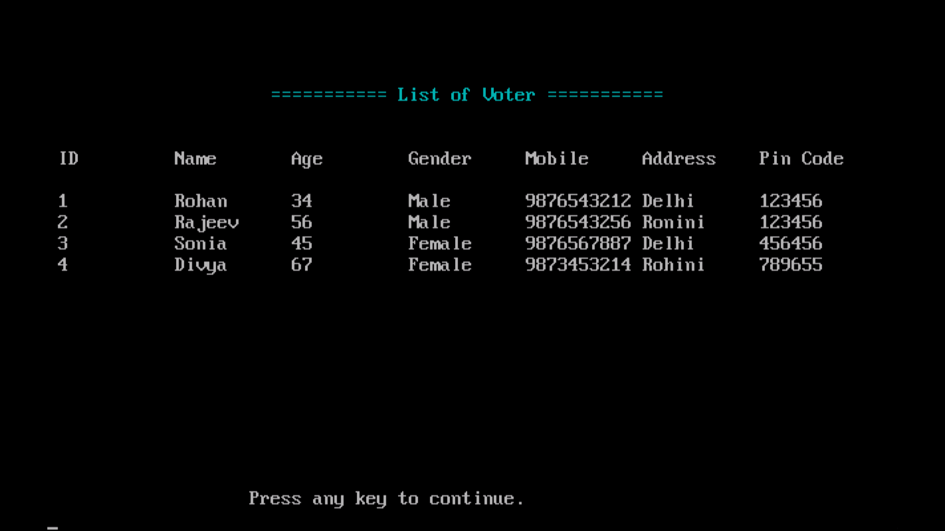

Slide 24
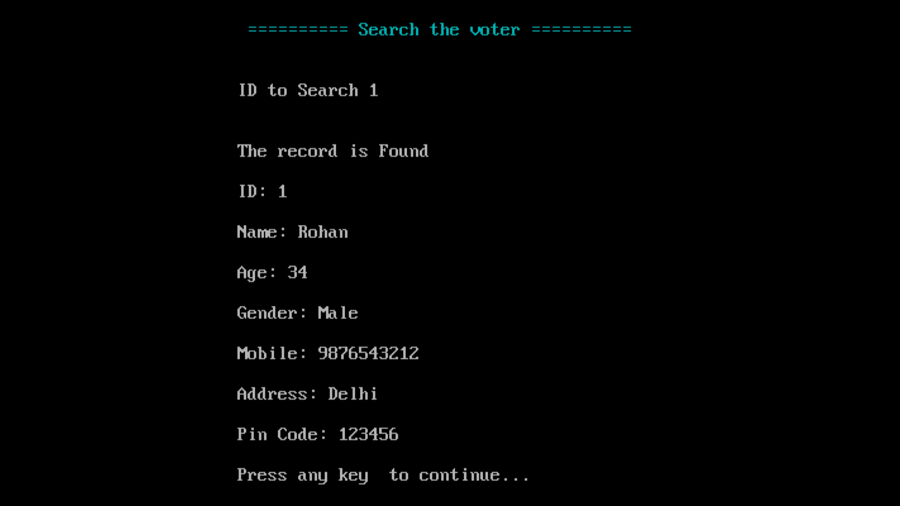

Slide 25
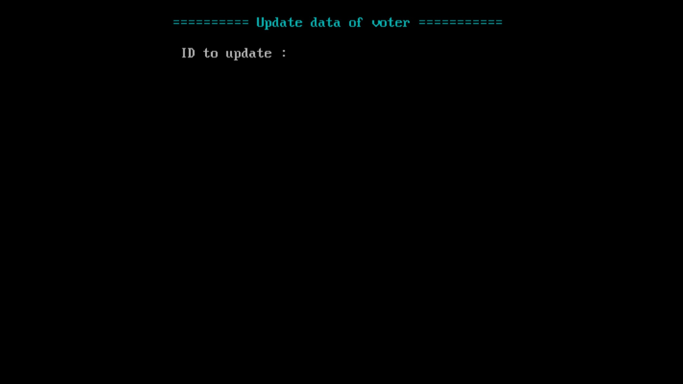

Slide 26
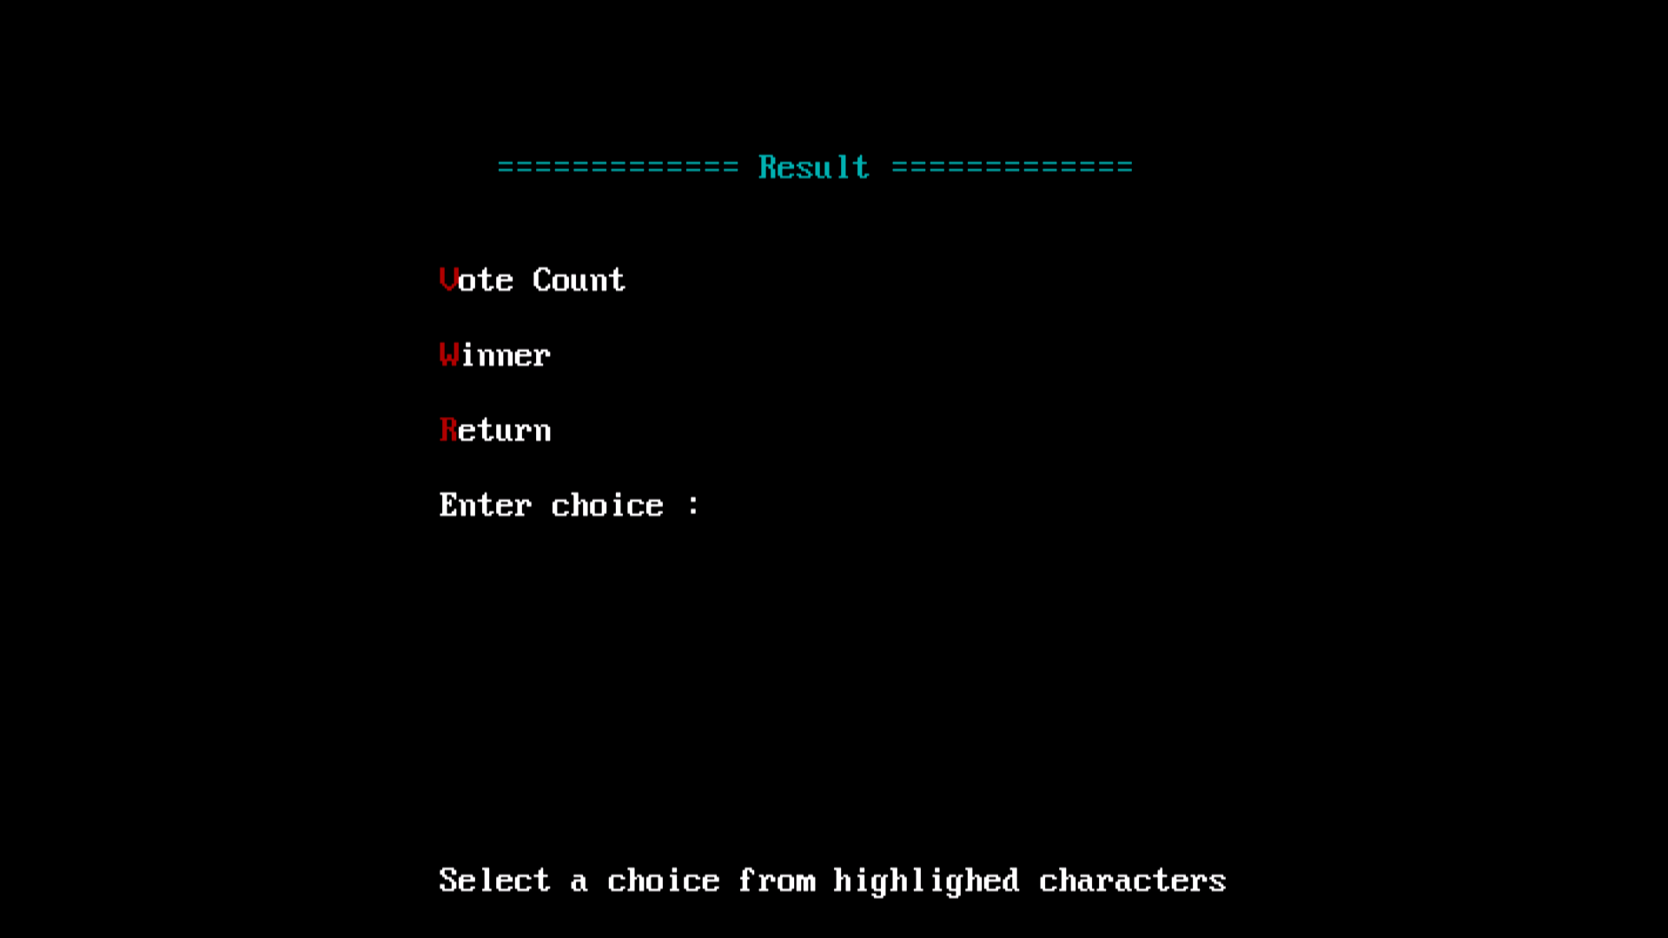

Slide 27
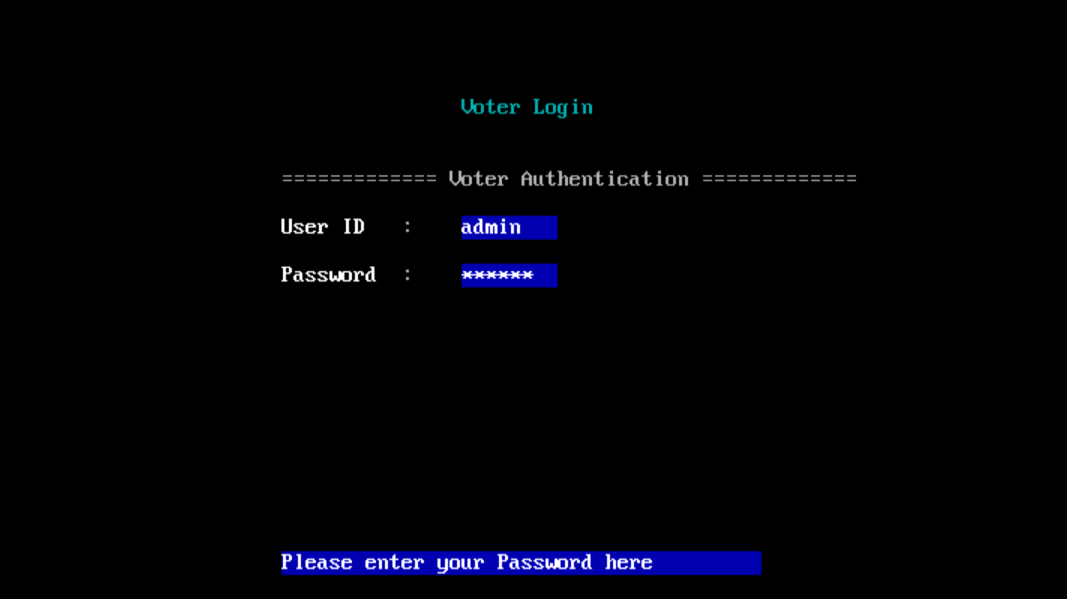

Slide 28
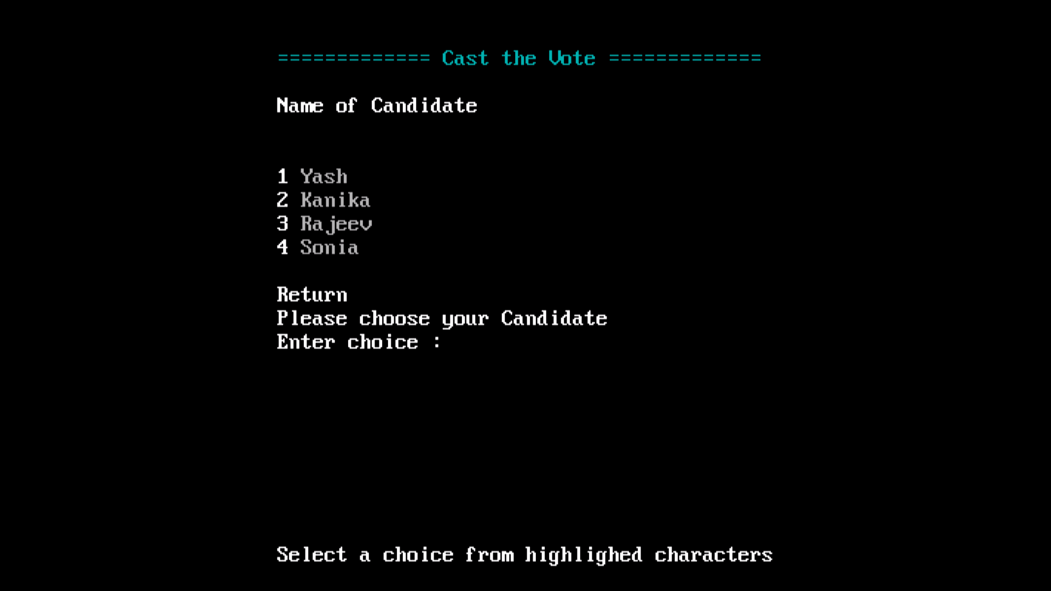

Slide 29


Slide 30
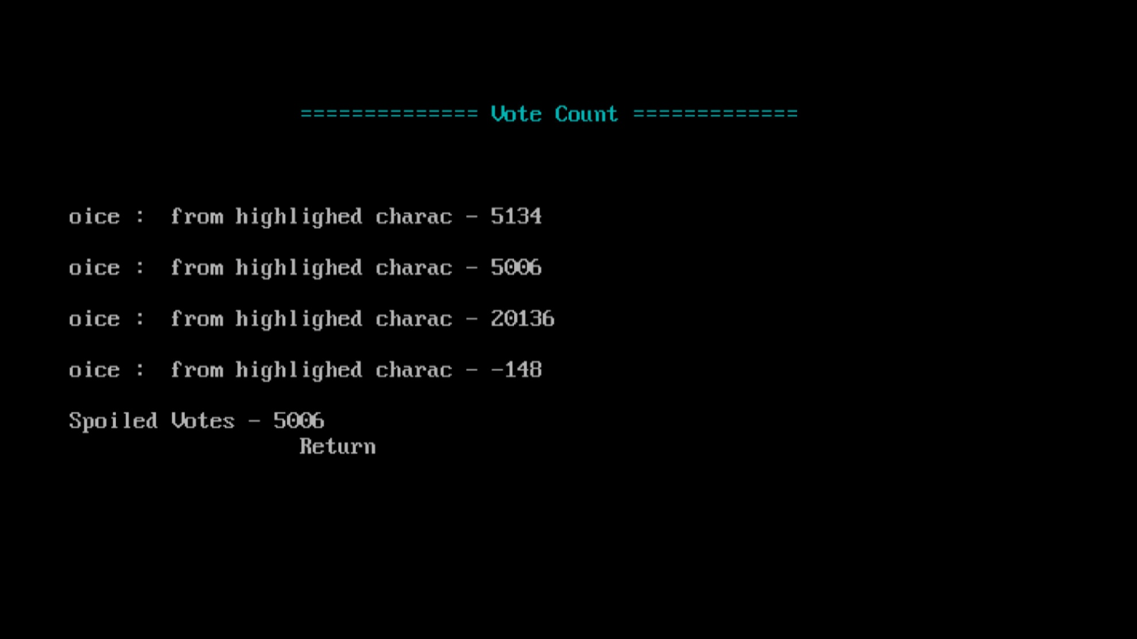
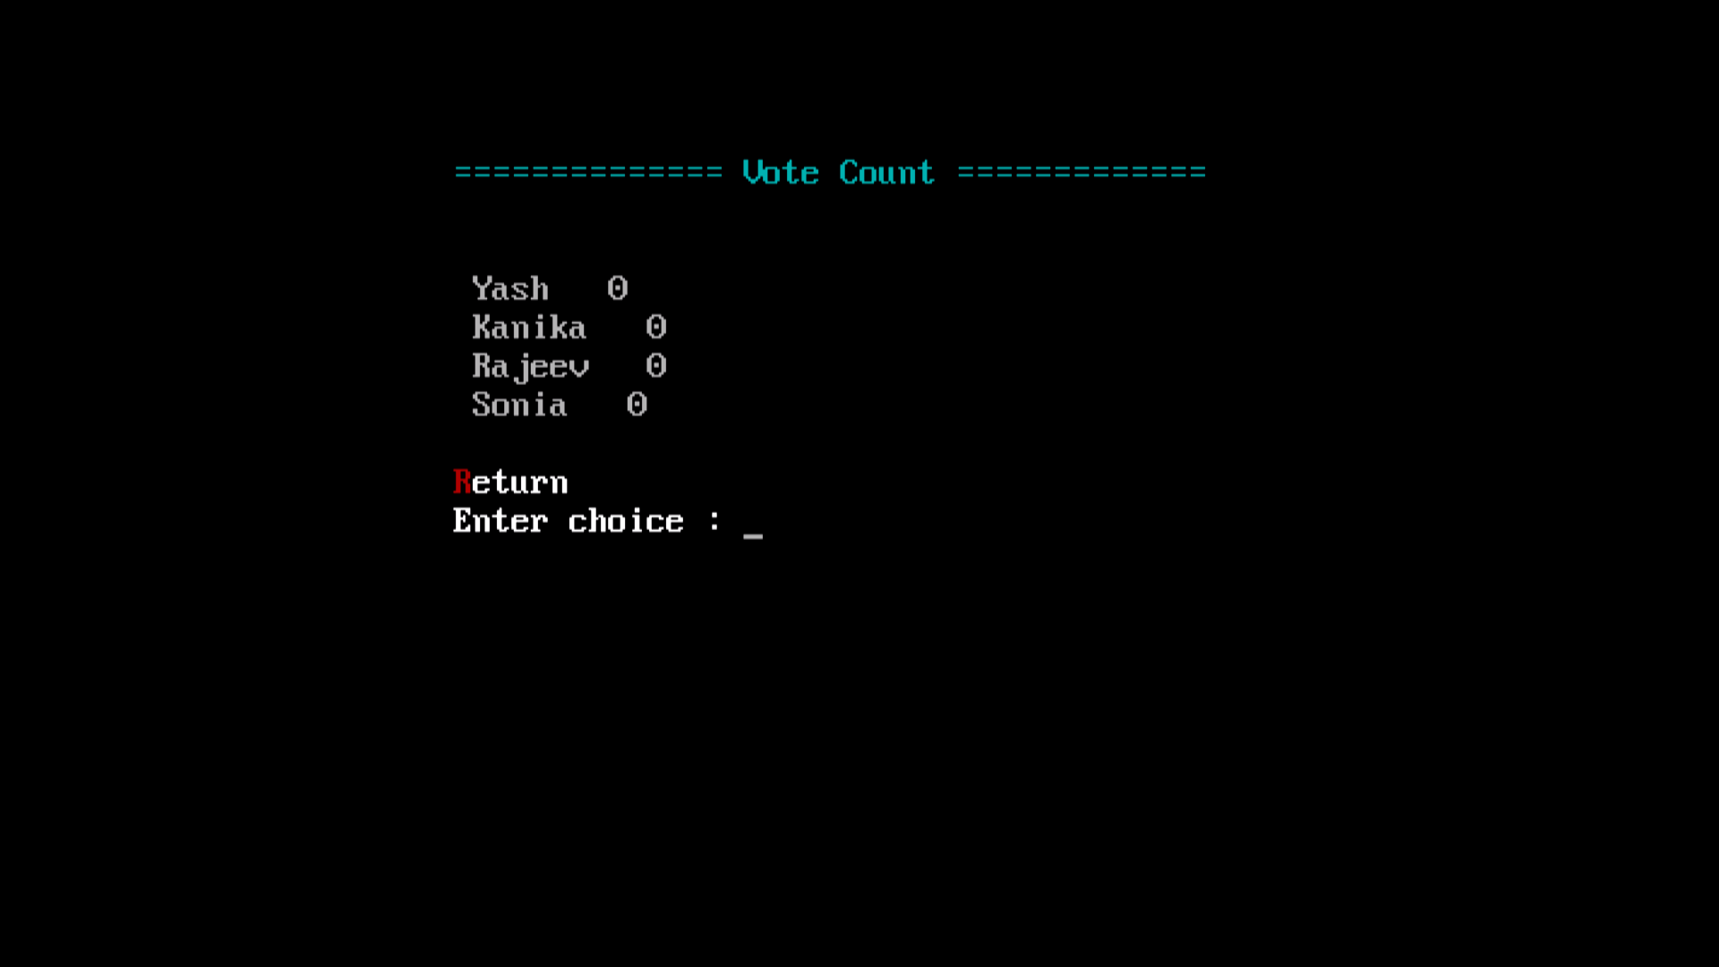

Slide 31
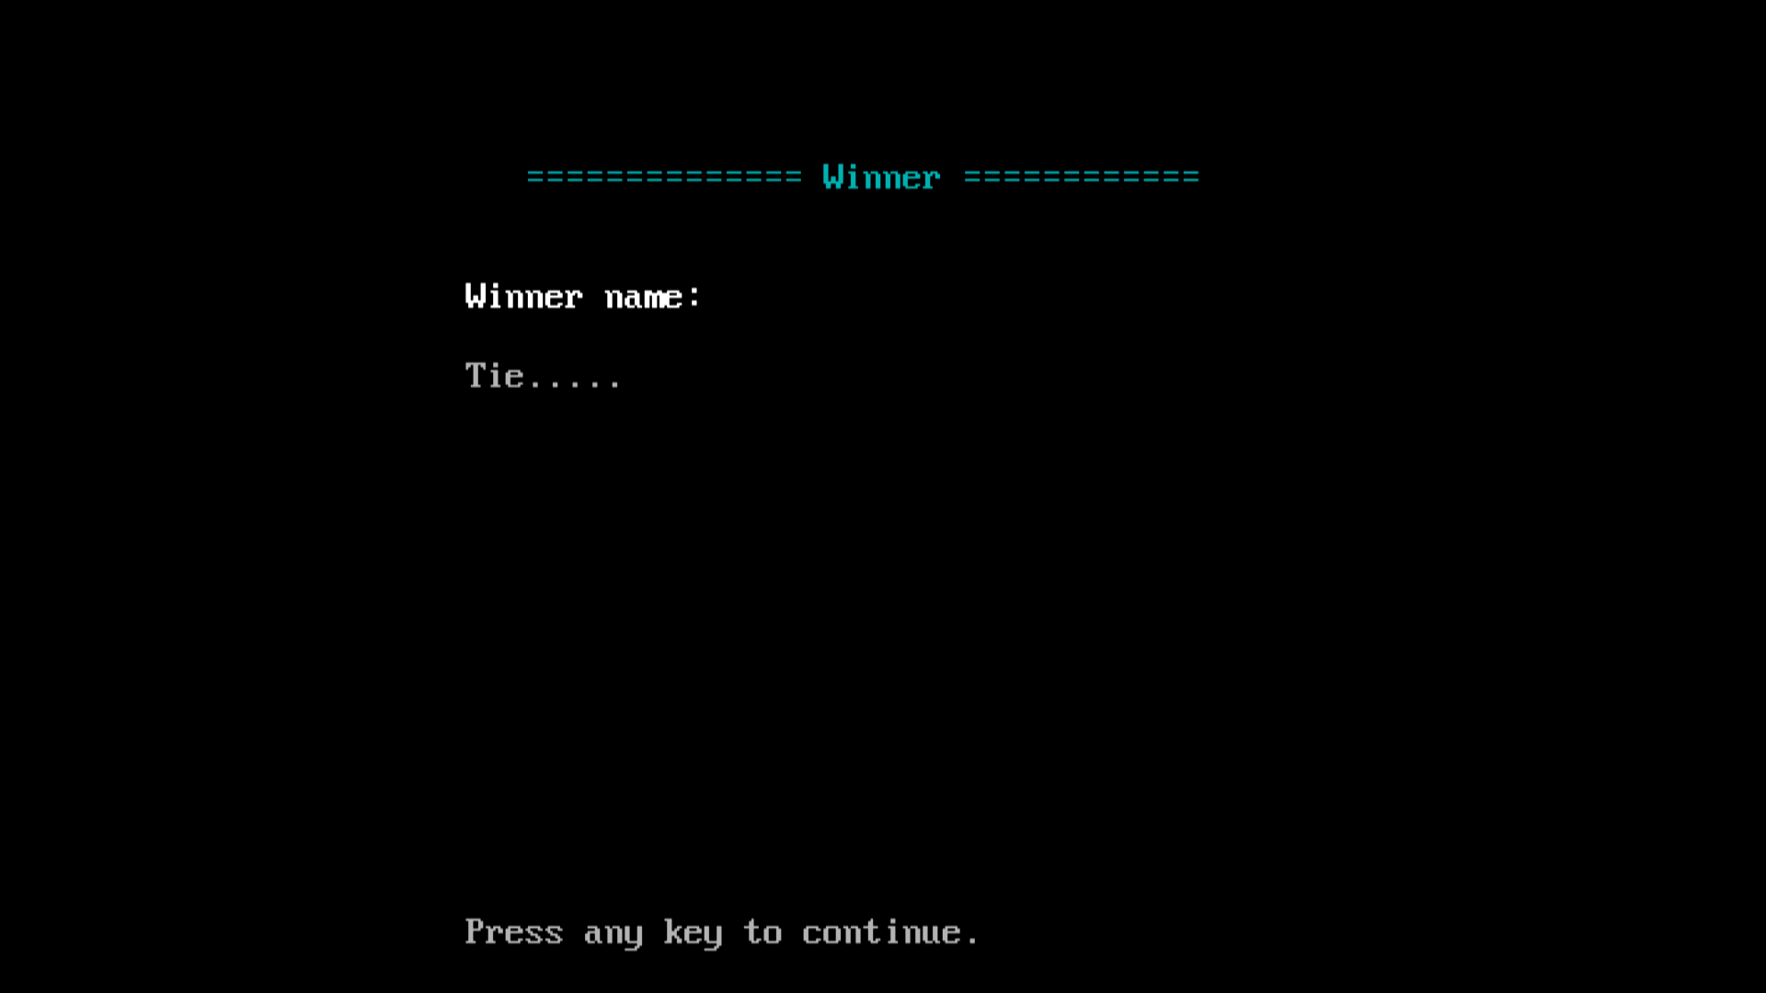

Slide 32
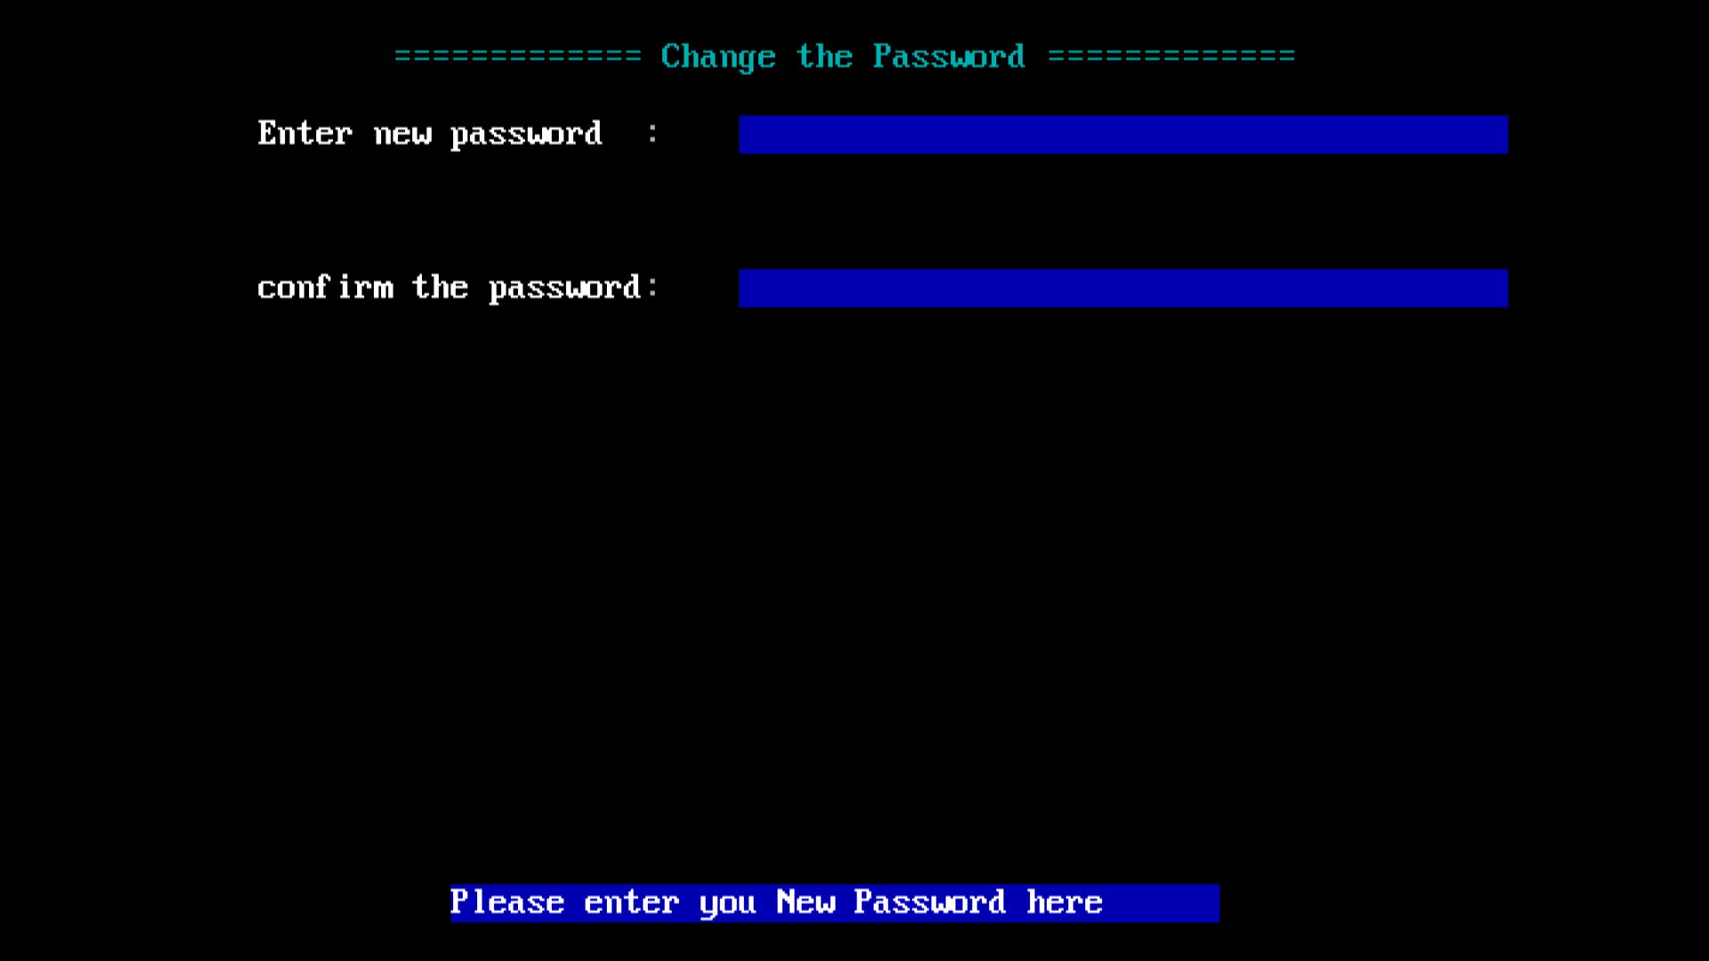

Slide 33
Conclusion
Online Voting System project aims to increase the voting percentages across the country; with the proposed system, people outside their hometown can also cast their vote.
It allows us to set up a flexible and trustworthy voting system.
Applicable for large as well as small group of people e.g., a batch, a class.
Keeps a record of every voting process.

Slide 34

Thank You

